Slide 1
FY 2021 Quarterly Marketing Presentation 4th Quarter

Slide 2
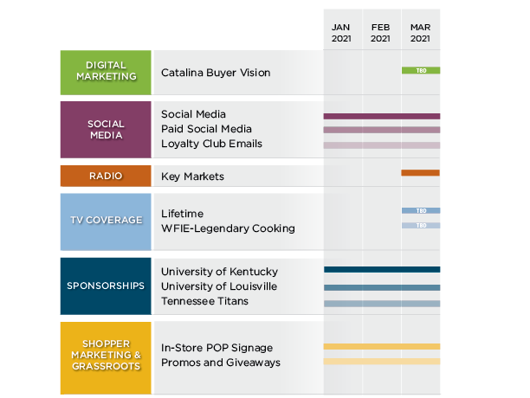
Q4 Kentucky Legend Marketing Schedule

Slide 3
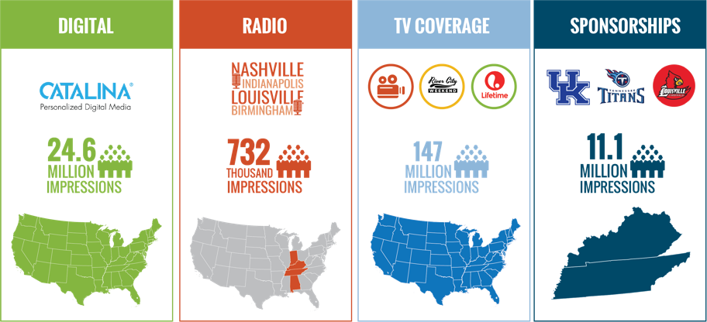
A Brighter Menu of Marketing Tactics | Q4

Slide 4
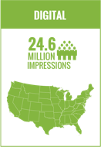
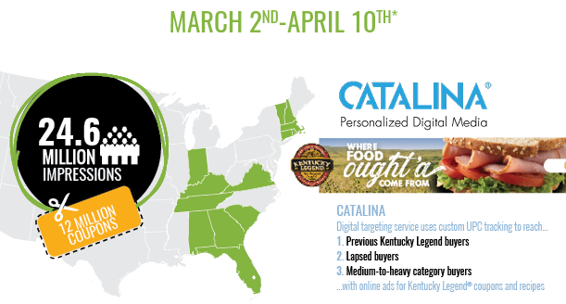

Slide 5
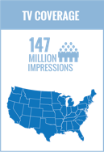
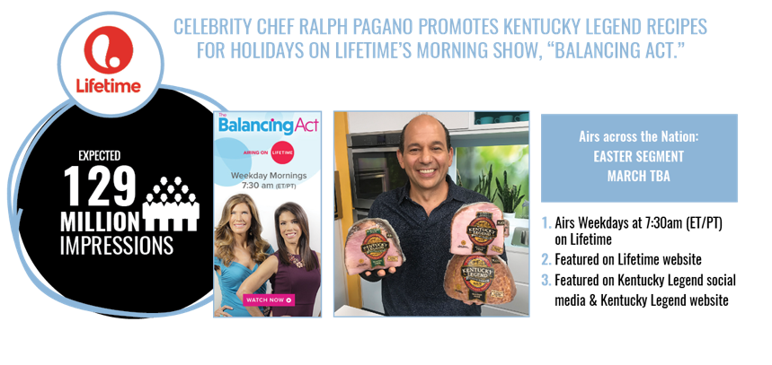

Slide 7
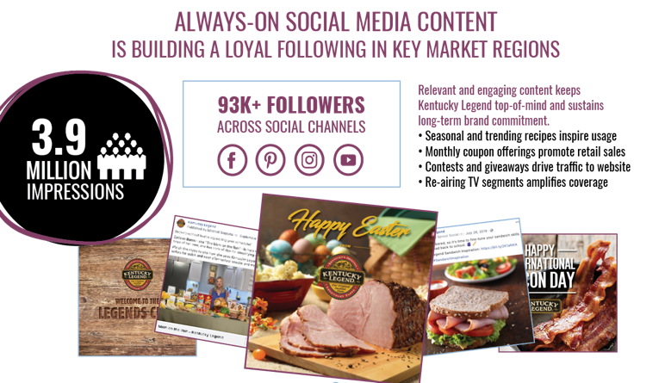

Slide 9
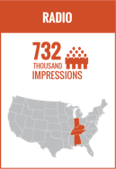
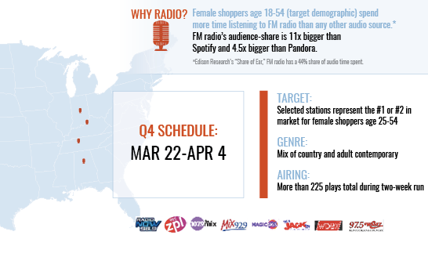

Slide 10
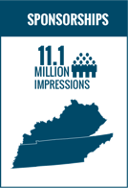
Notes:
Kentucky Legend is also the UK SEC Baseball Sponsor.

Slide 11
Notes:
Kentucky Legend is also the UK SEC Baseball Sponsor.

Slide 12
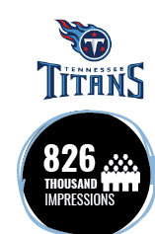
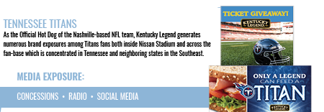
Notes:
Kentucky Legend is also the UK SEC Baseball Sponsor.

Slide 15
REGIONAL BRANDS

Slide 16
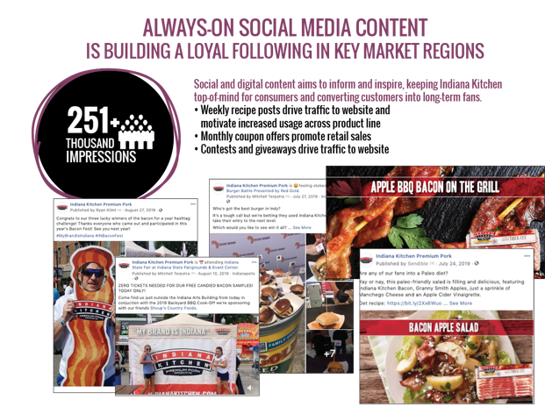

Slide 18
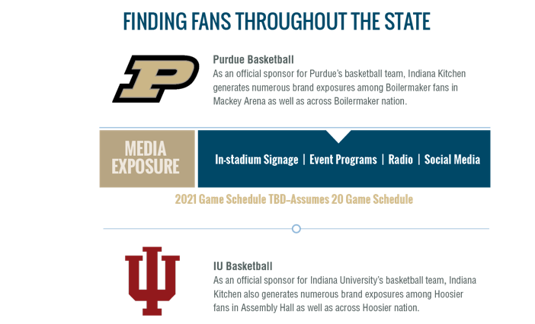
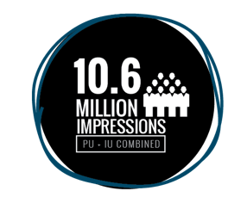

Slide 21
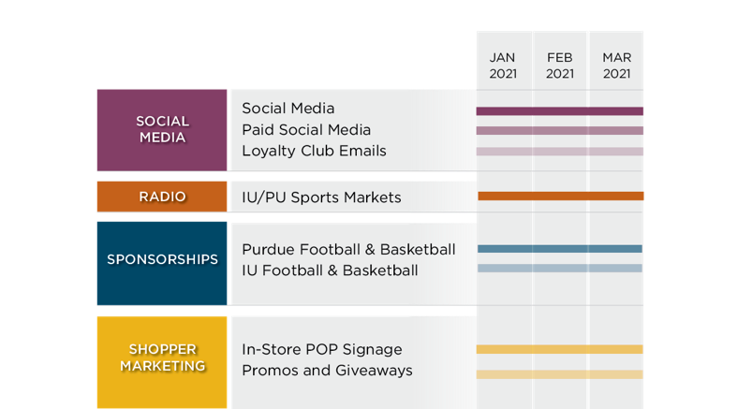

Slide 22
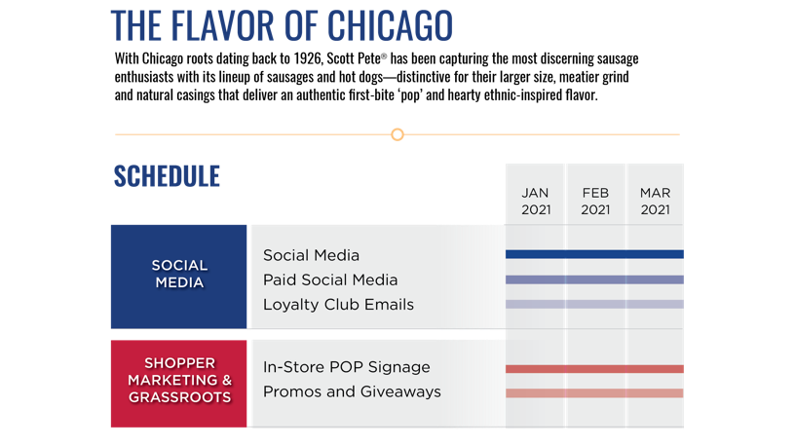
Notes:
We continue to see large increases in growth numbers for Scott Pete…..up 817 followers since November 2019 which is well over 100% growth.

Slide 23
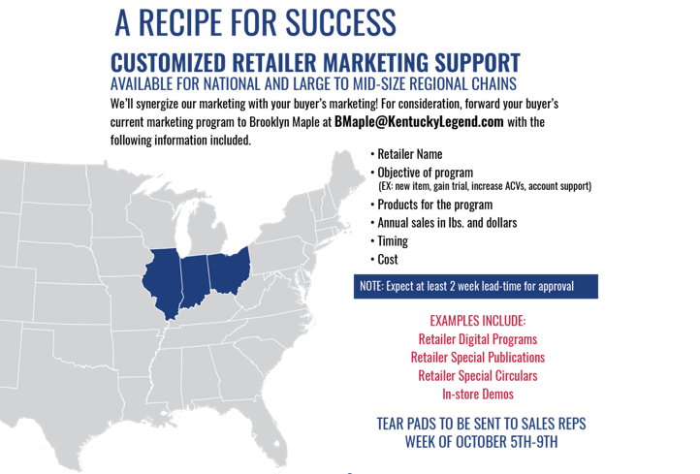

Slide 25
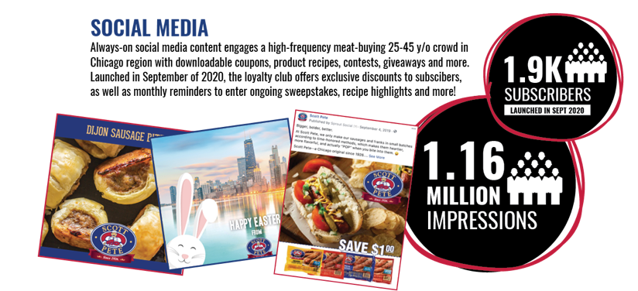

Slide 26
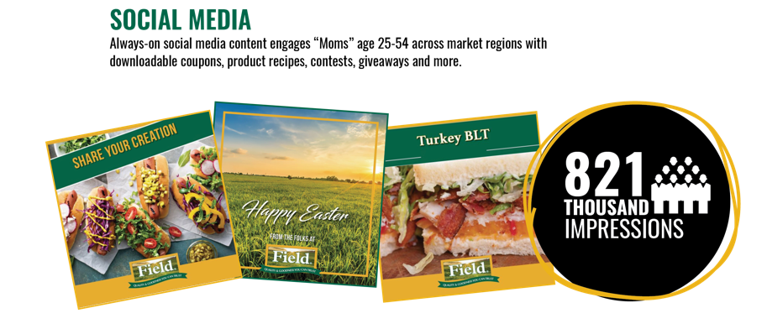
Notes:
Always on social media has helped Field reach over 100% growth since Nov 2019—and we can expect at least 625,000 impressions via social media alone in the 1st quarter.

Slide 27
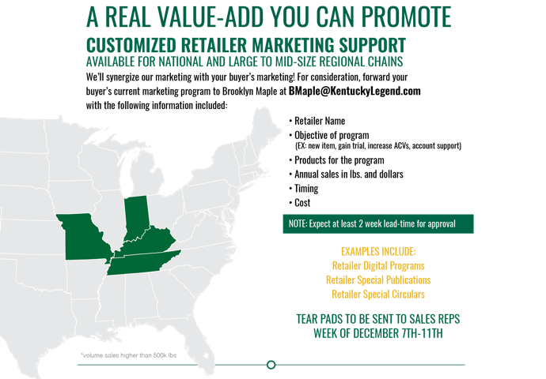

Slide 29
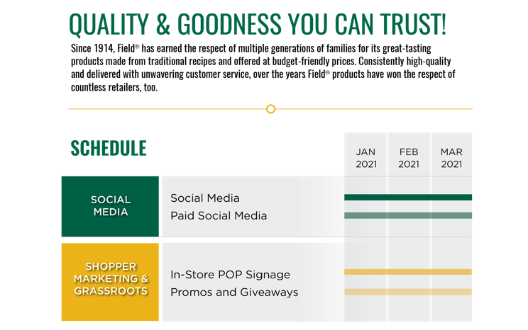

Slide 30
Notes:
Targeting Mom’s ages 25-54 is how we’ve seen 150 NEW followers via social media since Nov. which again accounts for over 100% growth. During Q1 we plan to continue to target Mom’s, anticipating over 450,000 impressions by delivering great content such downloadable coupons, product recipes, giveaways and more!

Slide 31
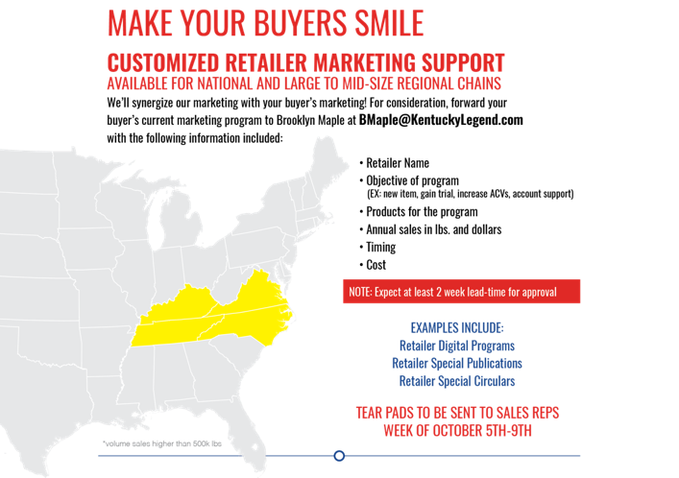

Slide 33
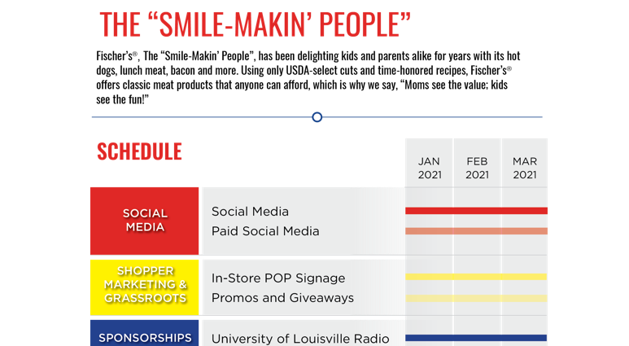

Slide 34
Thank you

